Slide 1
205, Nov 16, Class 24
Final project check-in
Development & Neuropsychology
Lifespan development from infants to cognitive dysfunction in aging

Slide 2
Developmental Research with Infants
Preferential Looking Technique
Forced-choice preferential looking
Violations of expectation
Core Knowledge
Pre-wired knowledge of the world in infancy
Sensitivity to language structure
Awareness of visual objects, physics

Slide 3
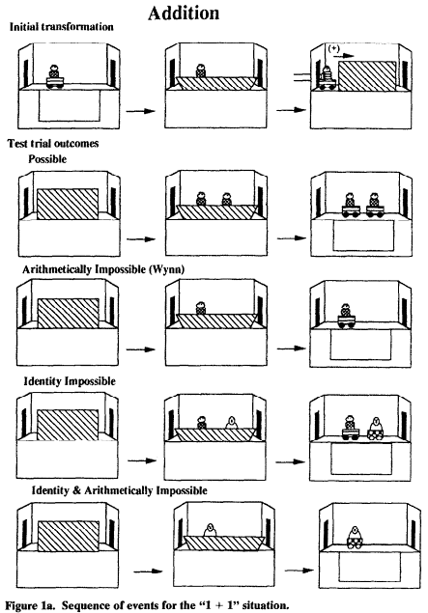
Numeracy example
Infant seated on parent’s lap facing the stage
20 3-5m old infants (of 36)
Experimenter waited until the infant looked at the display for 5s, then the display was occluded and additional objects introduced, then scene revealed
Two independent coders analyzed video recording of infant gaze

Slide 4
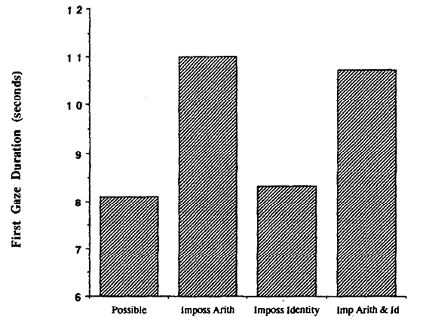
Viewing times
Babies looked longer at numerically impossible outcomes
1 -> 2 or 2 -> 1
Did not look longer at “identity” violations
Swapping toys
Appear to understand basic numerosity

Slide 5
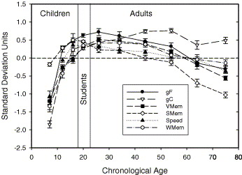
Lifespan development
Development of cognitive change
Growth in children
Increasing to ~30
Decline in aging
From 30-35
General processing speed, working memory, “fluid” decreases
Knowledge increases

Slide 6
Case Study Research Methods
Qualitative descriptions of special cases
Non-experimental
Drive theory and subsequent experimental research
Illustrate and illuminate differences in human experience
Oliver Sacks, “The Man Who Mistook His Wife for a Hat”

Slide 7
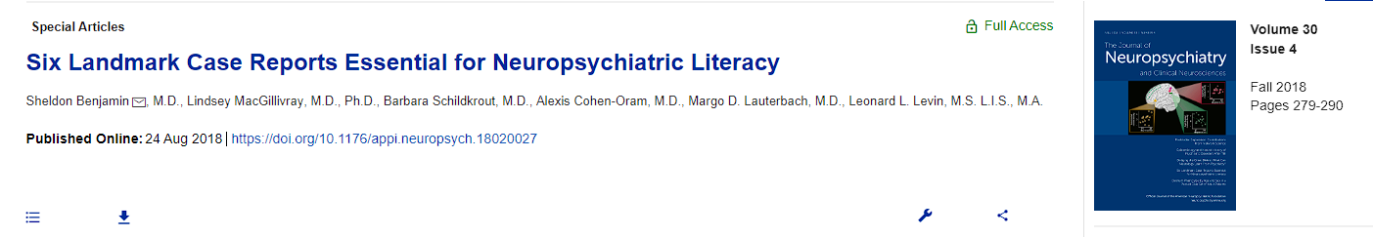
Landmark Case Studies
Phineas Gage
“Tan”
Auguste Deter
“S”
“JP”
“HM”

Slide 8
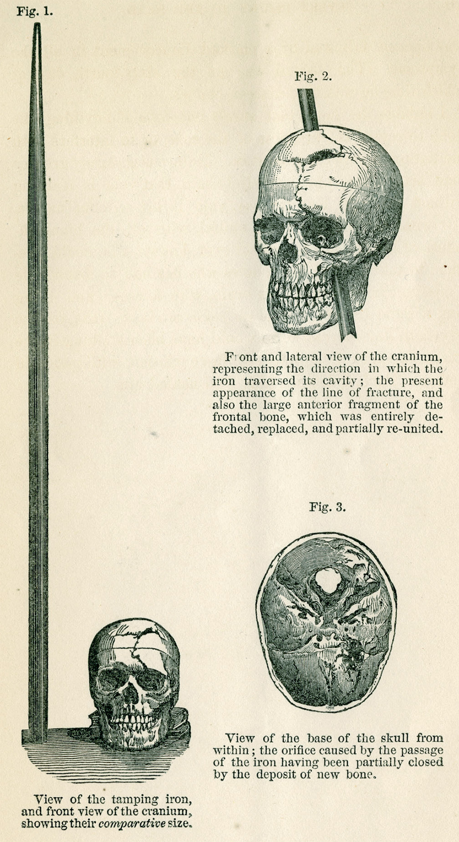
Phineas Gage
1848
Tamping iron accident
74 days recovery
20 years later
It was only in a follow-up paper 20 years later that Harlow described Gage’s behavioral changes after recovery. Gage had not been rehired as foreman because he had become disinhibited, with the “animal passions of a strong man,” “impatient of restraint or advice” and, “indulging at times in the grossest profanity (which was not previously his custom).”1 Having formerly been regarded as smart, efficient and capable, Gage’s friends famously stated that after the accident he was “no longer Gage.”

Slide 9
Cognitive Neuroscience
“Tan”
1861 description of an aphasic patient by Broca
Language impairment and post-mortem identification of left anterior frontal lobe damage
Right side paralysis and language dysfunction already well-known
Localization of language as a cognitive function
Wernicke
Modularity of cognitive operations

Slide 10
Case Studies
Auguste Deter
First characterization of Alzheimer’s disease
Solomon Shereshevsky, “S”
Luria’s subject in “Mind of a Mnemonist”
Extraordinary memory, personality problems
JP
Childhood prefrontal cortex damage and severe comportment problems
Henry Molaison, H.M.
Characterization is the foundation of modern memory systems

Slide 11
Patient EP
Anterograde amnesia similar to HM
Extensive bilateral medial temporal lobe damage due to encephalitis
Extremely impaired memory
https://youtu.be/7Grh3PeEMIg?t=187

Slide 12
Final project presentations
Organize like a paper
Introduction: background and motivation for hypothesis
Methods: specific operational definitions, DV measure, procedure
Results: hypothesized if data not yet available
Graph hypothetical 2x2 results showing interaction
Discussion: what will it mean if it works
Each group member can do one section
Aim for 10-12 minutes
3 groups/hour with questions

Slide 13
For Fri 11/18
Second midterm exam
Presentation schedule for next week
Monday
Status and memory
Aggression priming
Face memory
Wednesday
Emotional priming and Stroop
Open-mindedness and Food
Fancy color names

